Slide 1


Slide 2
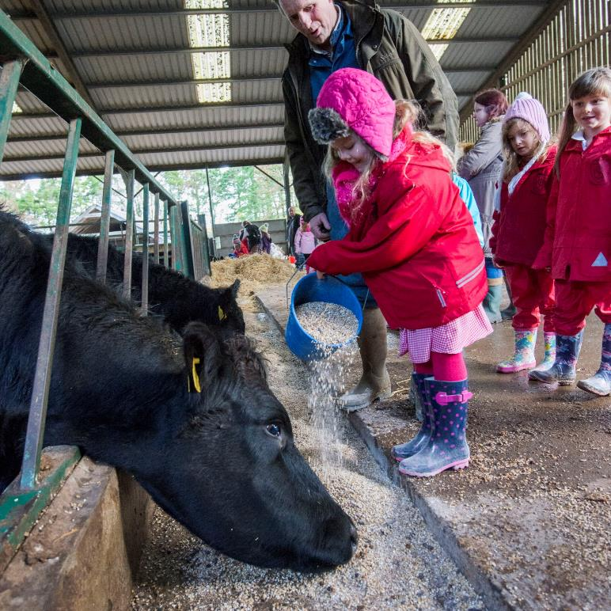
What is RHET?
Established in 1999
Provides free resources, farm visits and classroom speakers which allow children to learn more about Scottish farming, food and countryside
Currently interfaces with around one in eight of Scottish schoolchildren through 12 local Countryside Initiatives
Takes over 16,000 children out to farms each academic year
Provides more than 28,000 children with a classroom speaker talk

Slide 3
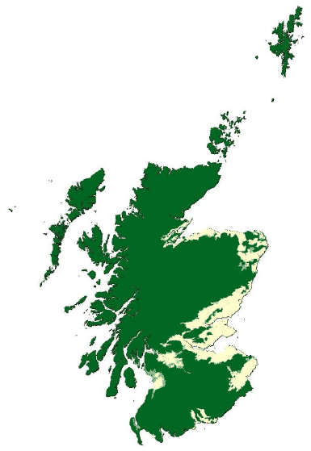
What we produce in Scotland
80 % of Scotland’s land area is agricultural land.
= 6.2 million hectares.
most of Scotland’s agricultural land is used for livestock grazing.

Slide 4
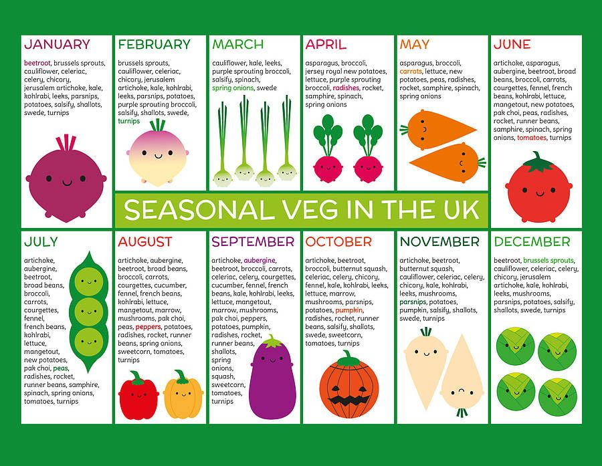
Eating seasonally
Eating fruit and vegetables when they are available
Knowing the seasons for fruit and vegetables

Slide 5
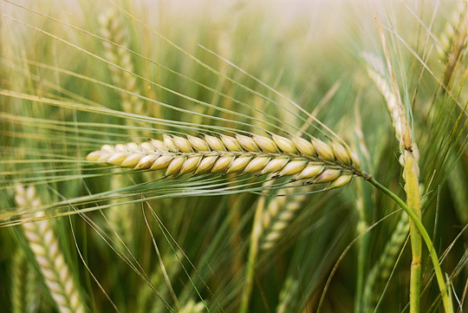
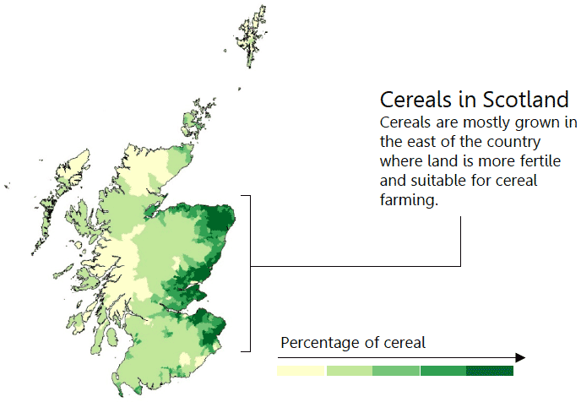
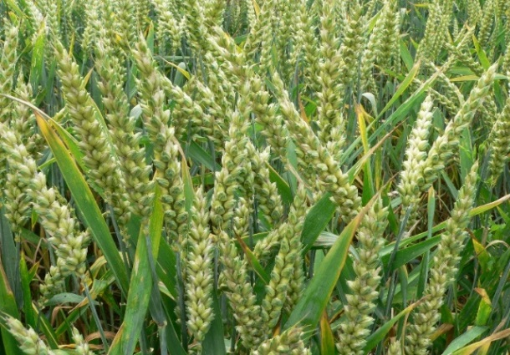
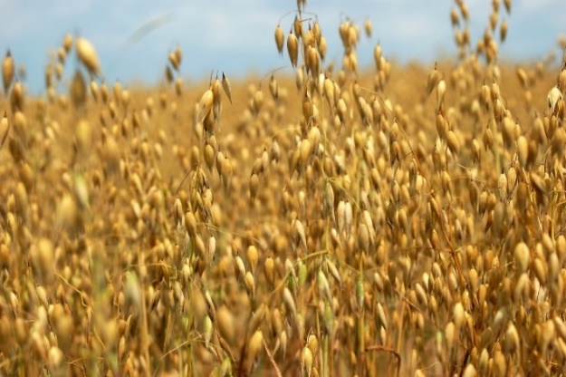
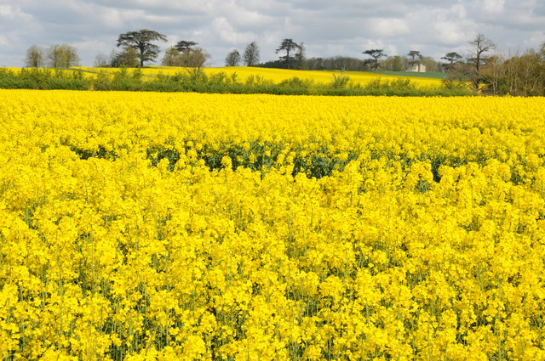
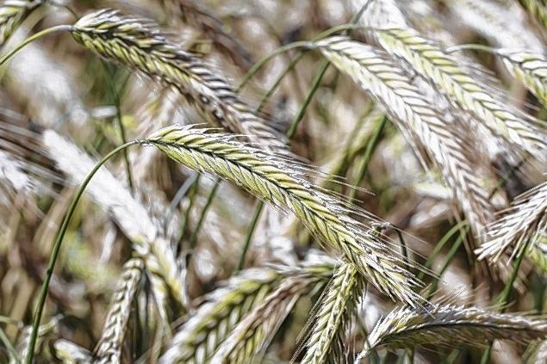
Scottish cereals
Barley
459,400 hectares
Wheat
Oats
Oilseed Rape
Rye

Slide 6
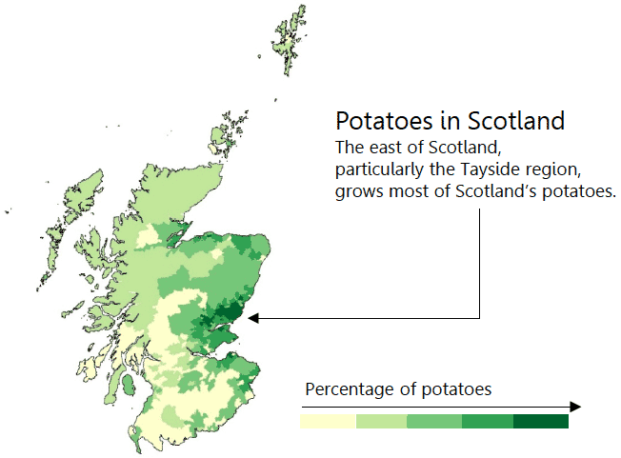
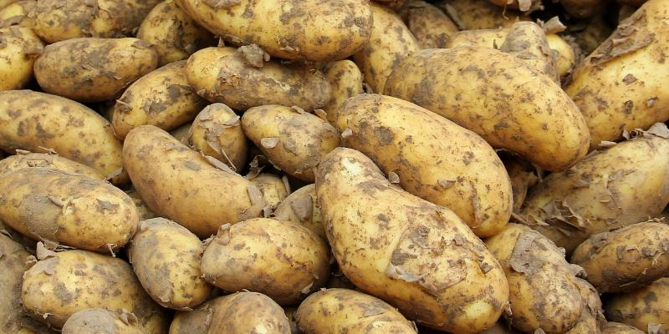
Potatoes
27,400 hectares
Both seed (planting)
and ware (eating)
potatoes

Slide 7
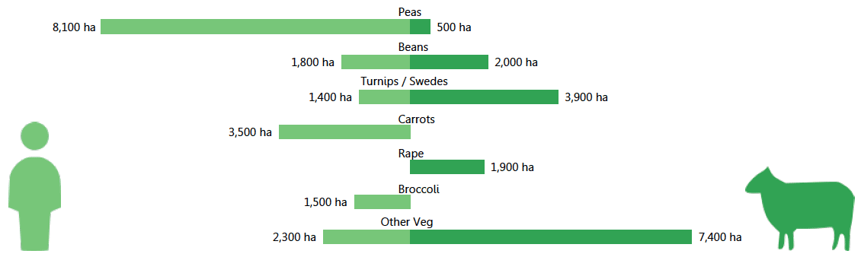
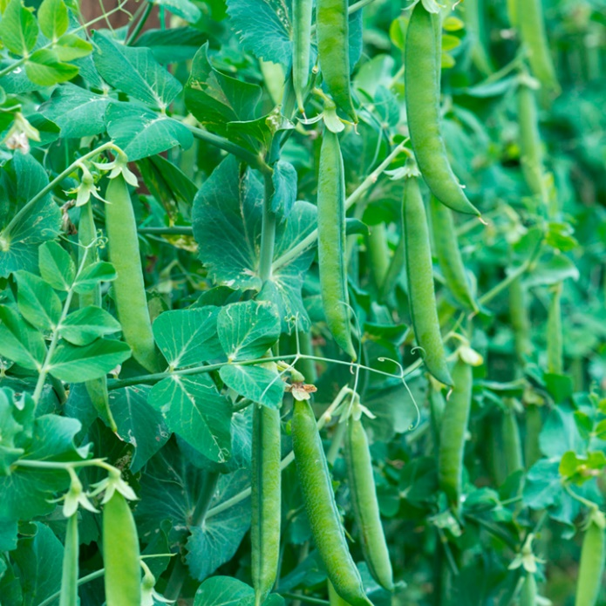
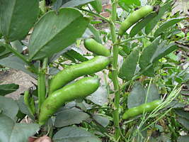

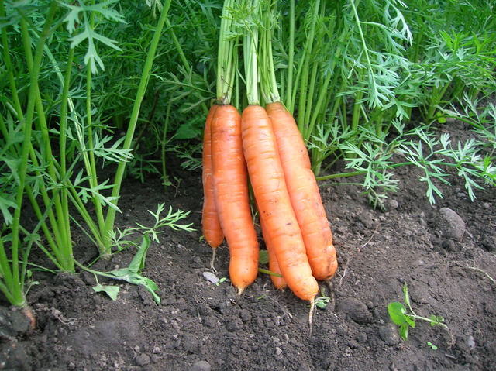
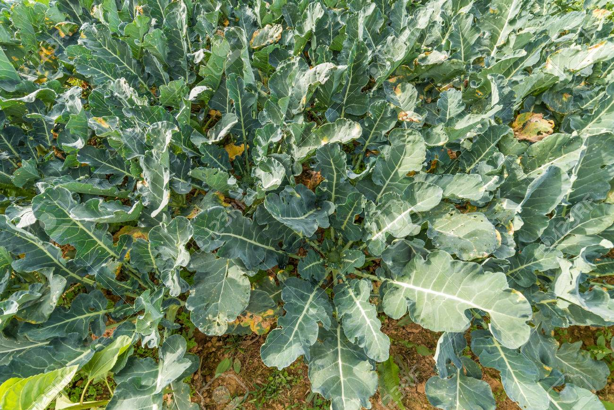
Vegetable production
Vegetables
18, 900 hectares
Human consumption
16,800 hectares
Animal consumption
Carrot harvesting
Peas
Beans
Swedes
Carrots
Broccoli

Slide 8
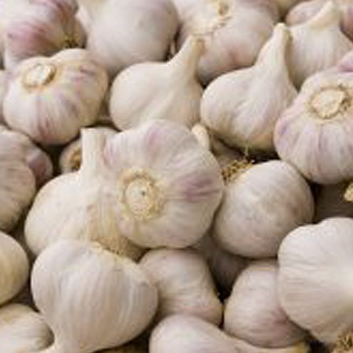
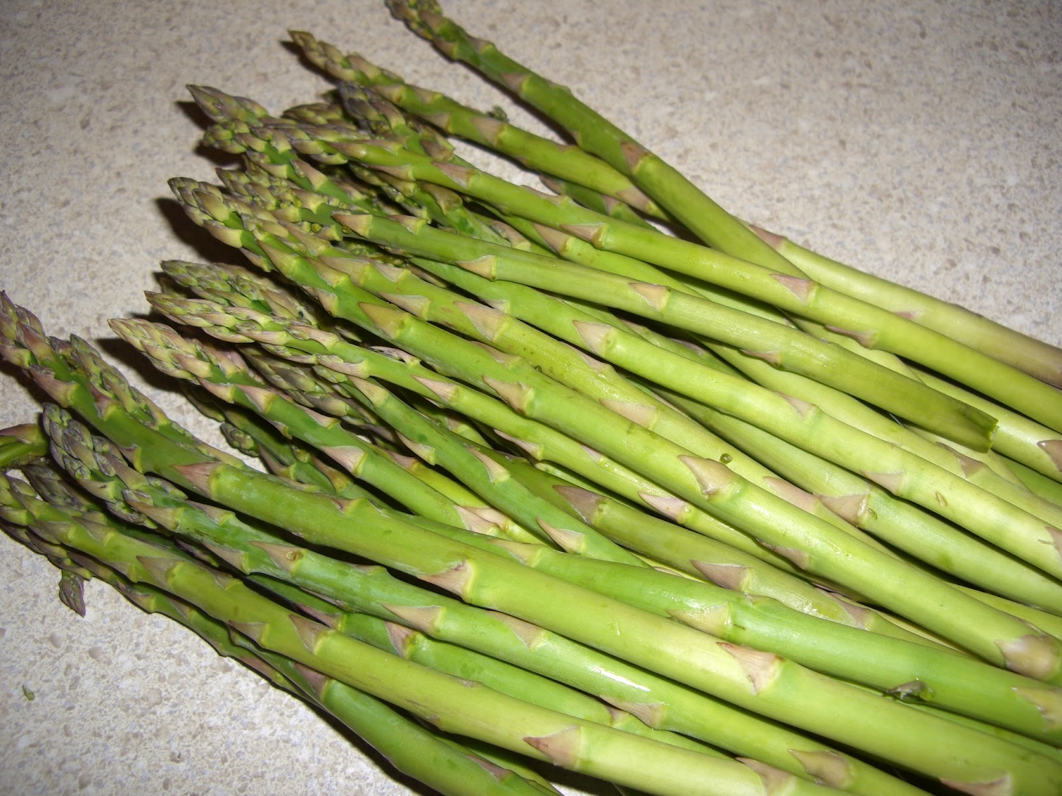
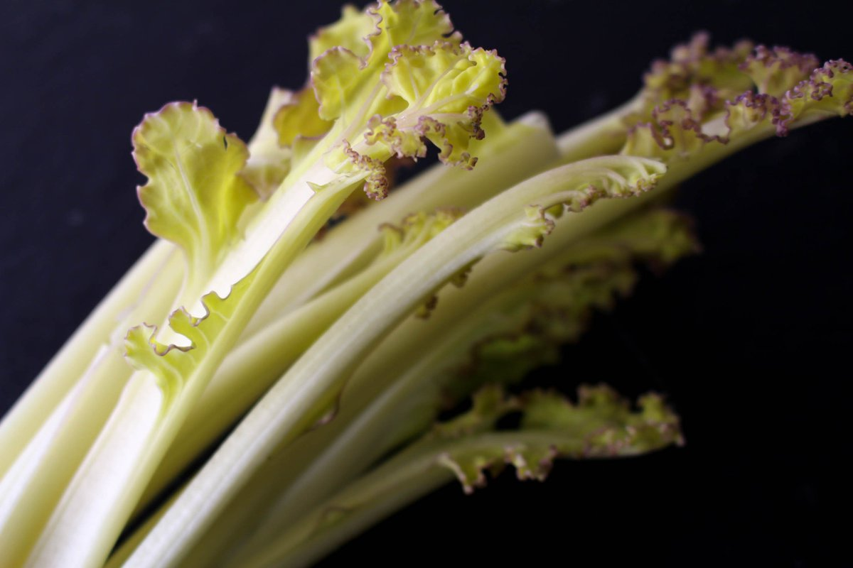
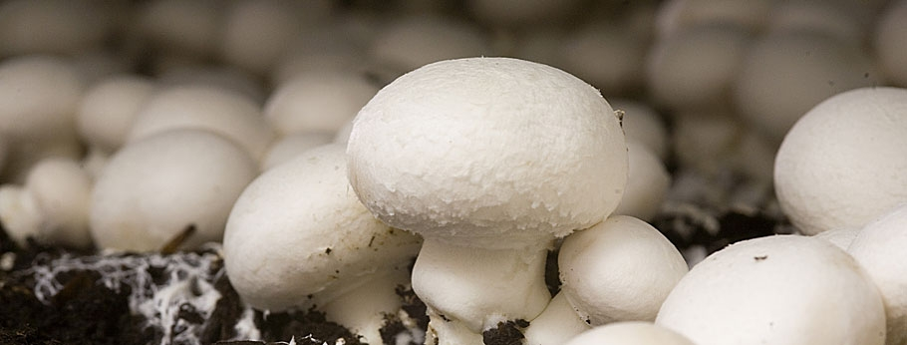
Unusual vegetables
garlic
Sea kale
Aspapagus
mushrooms
Asparagus
Garlic
Sea Kale
Mushrooms

Slide 9
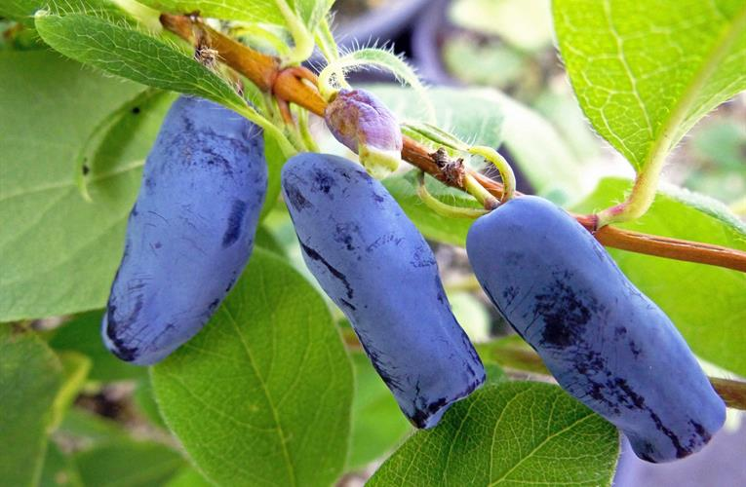
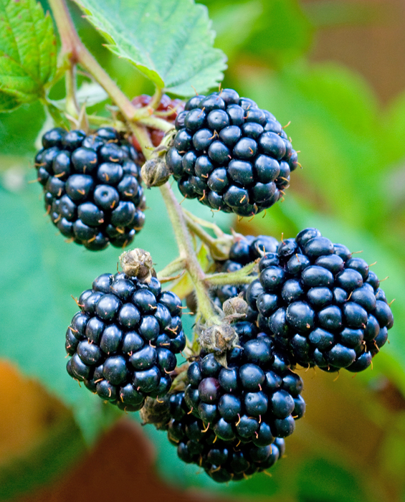
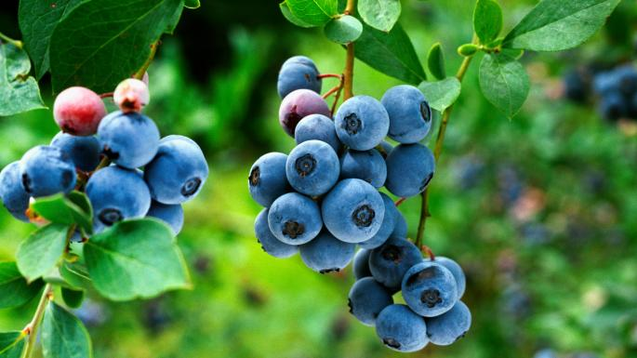
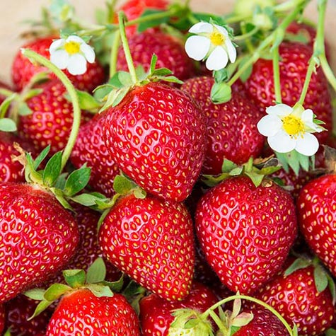
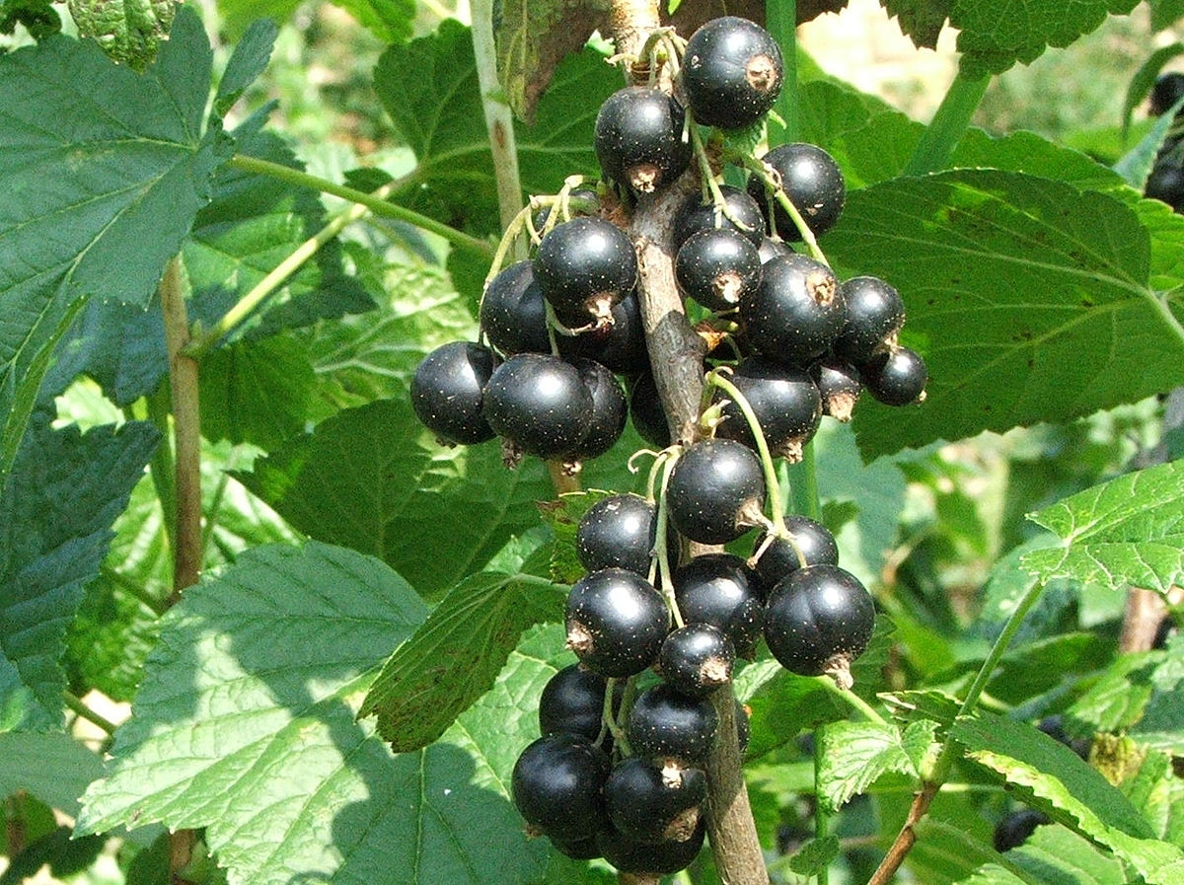
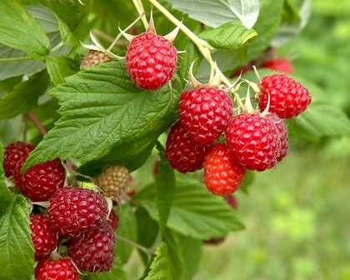
Soft fruit production
Blackberries
Honeyberries
Blueberries
70 % of the
total area of
soft fruit in
Scotland is
grown under
cover
Strawberries
Blackcurrants
Raspberries

Slide 10
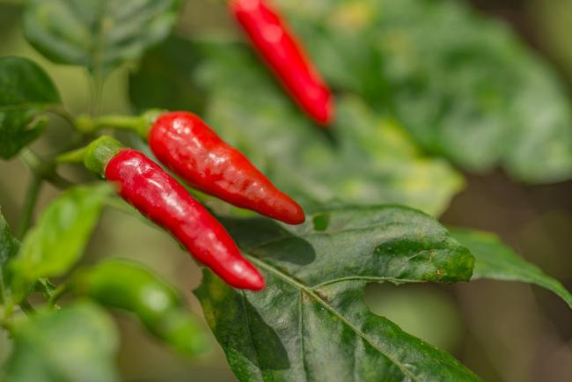
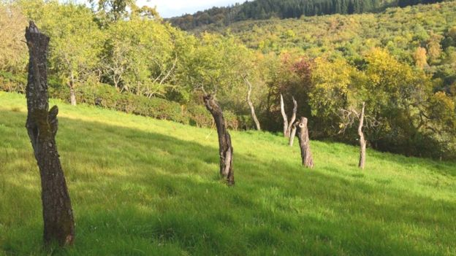
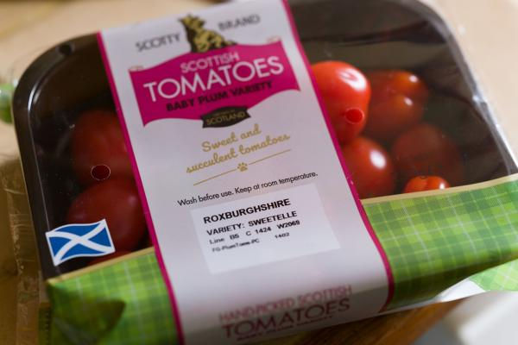
Other fruit
Tomatoes
Apples
chillies
Tomatoes
Chillies
Fruit trees – plums and apples

Slide 11
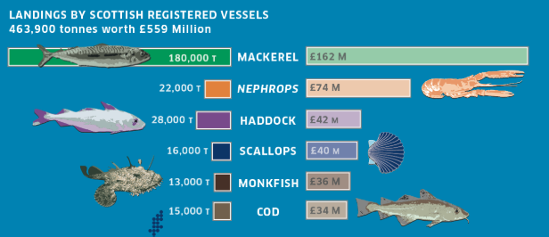
Fish and shellfish

Slide 12
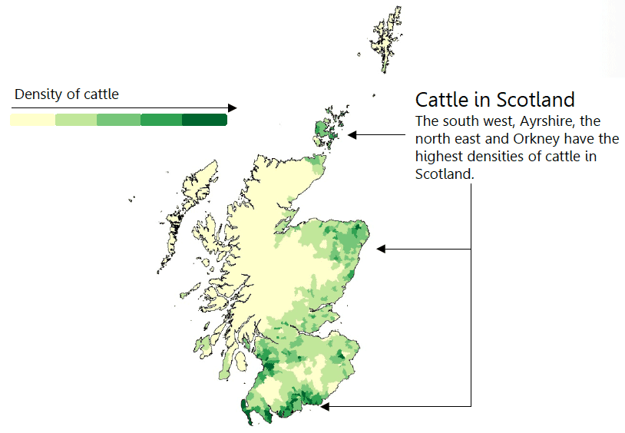
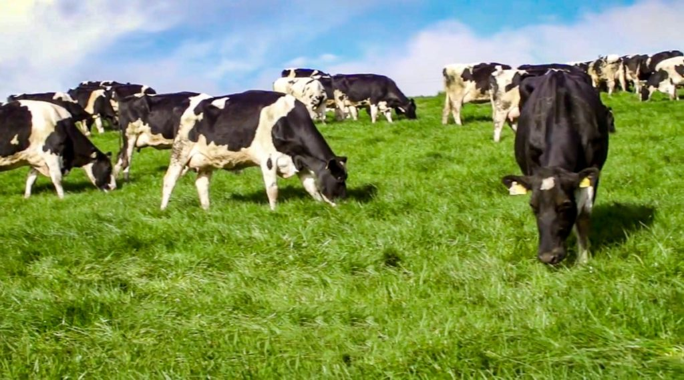
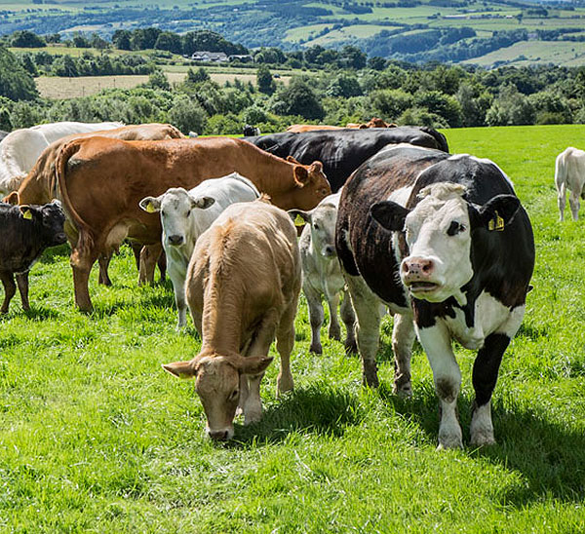

Cattle
1.76 million cattle in Scotland
Dairy cows
Beef cows

Slide 13
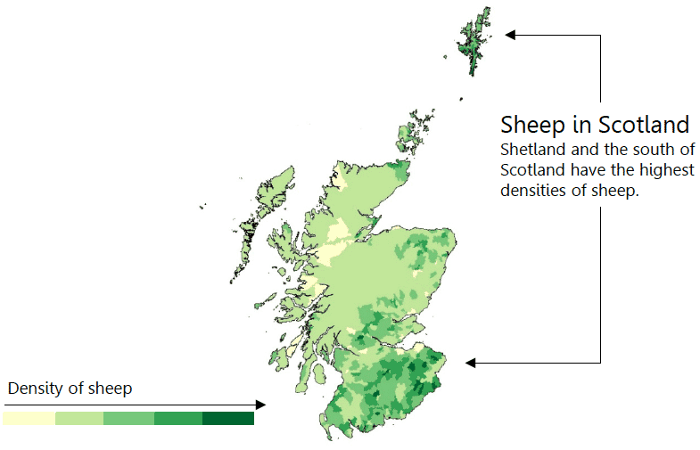
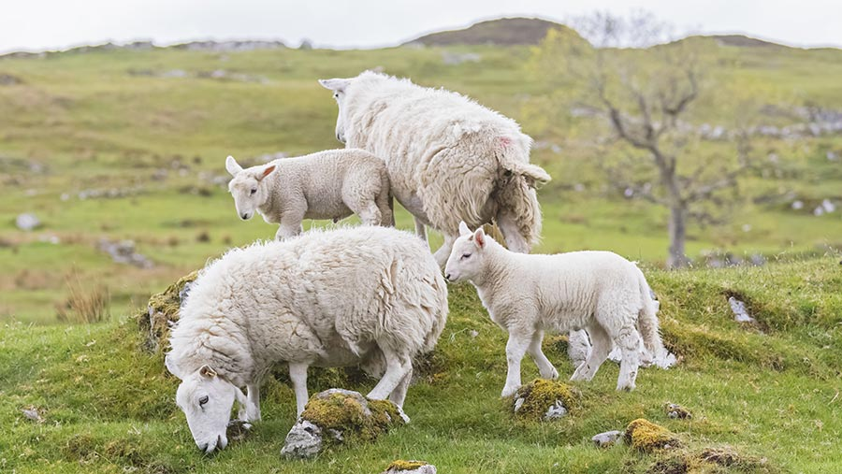
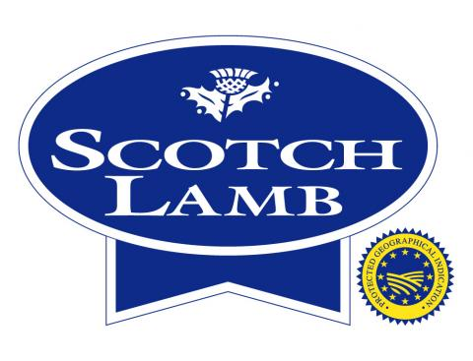
Sheep
6.59 million sheep in Scotland

Slide 14

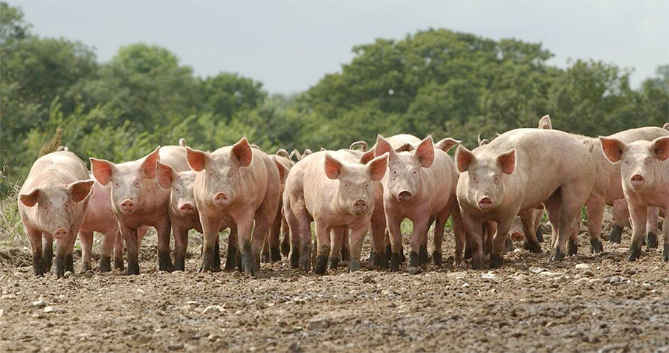
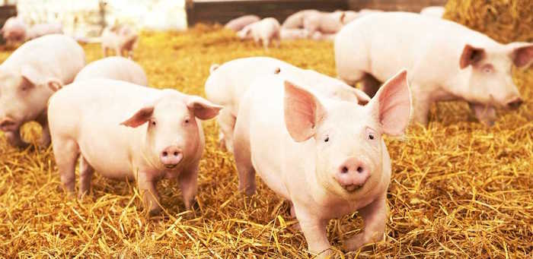
Pigs
317,000 pigs
Indoor and outdoor production

Slide 15
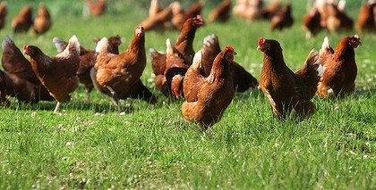
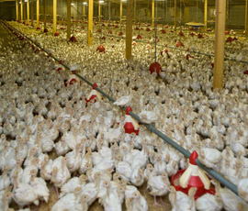
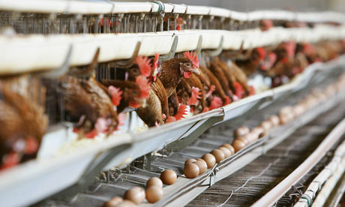
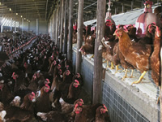
Poultry
14.5 million poultry birds in Scotland
More egg laying poultry than meat producing poultry
BROILERS
FREE RANGE
CAGED
BARN

Slide 16
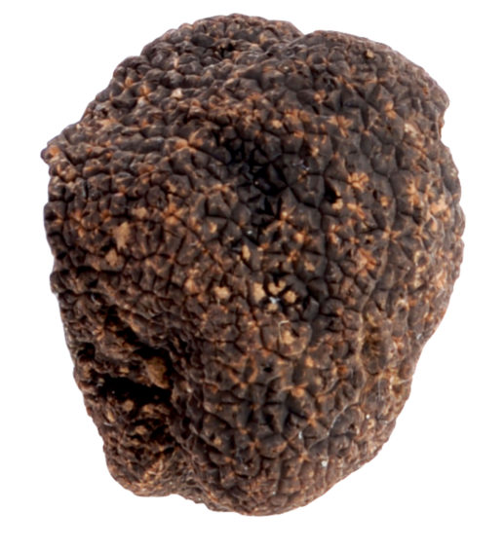
Truffles
Truffles are a type of fungi that grow on the root system of living trees
Truffles can sell for £800 per kg
There are a few farms in Scotland growing truffles

Slide 17
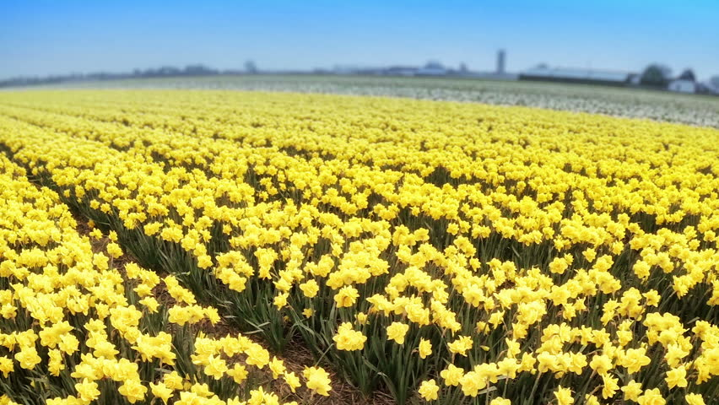
Daffodil stems

Slide 18
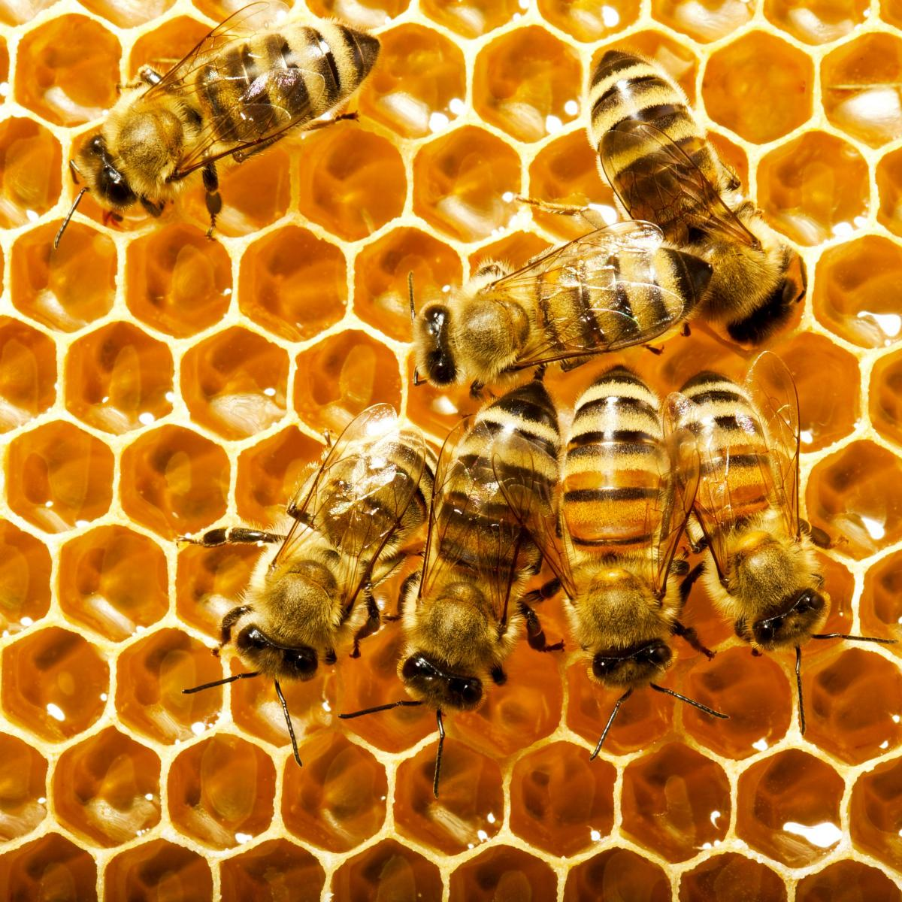
Honey
Bees produce honey
There are 4,100 beehives in Scotland
The taste of the honey depends on the flowers the bees have visited to make it
Scottish Parliament had its own hives

Slide 19
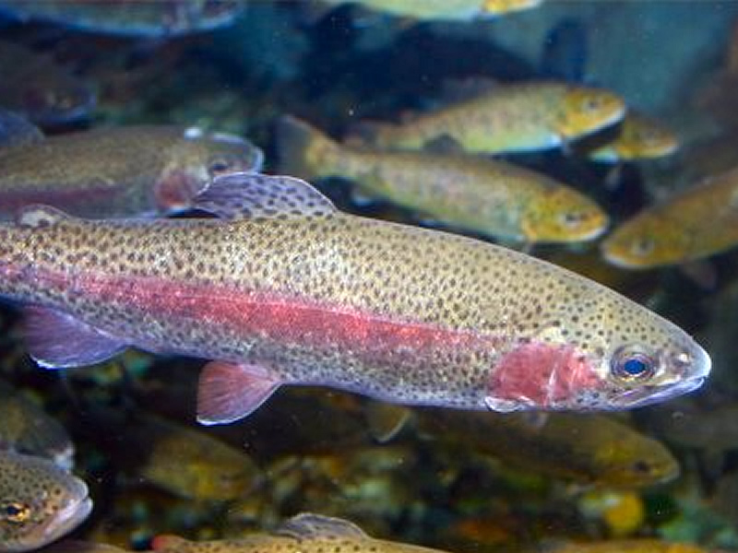
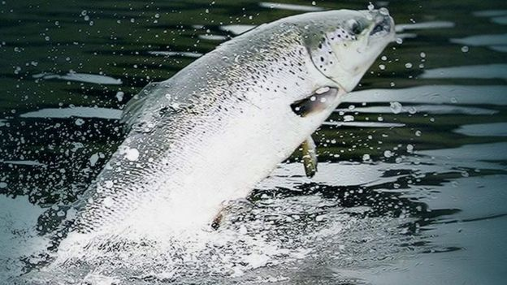
Aquaculture
162,817 tonnes
Scottish aquaculture is dominated by Atlantic salmon but rainbow trout, brown trout and halibut are also farmed
Rainbow trout
Salmon

Slide 20
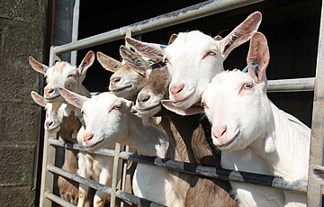
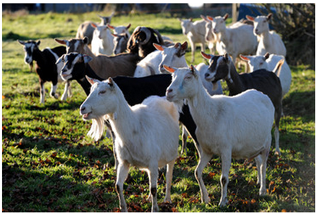
Goats
Goats may be kept for milk (and cheese) or meat
One of the key breeds for meat production in Scotland are South African Boer Goats

Slide 21
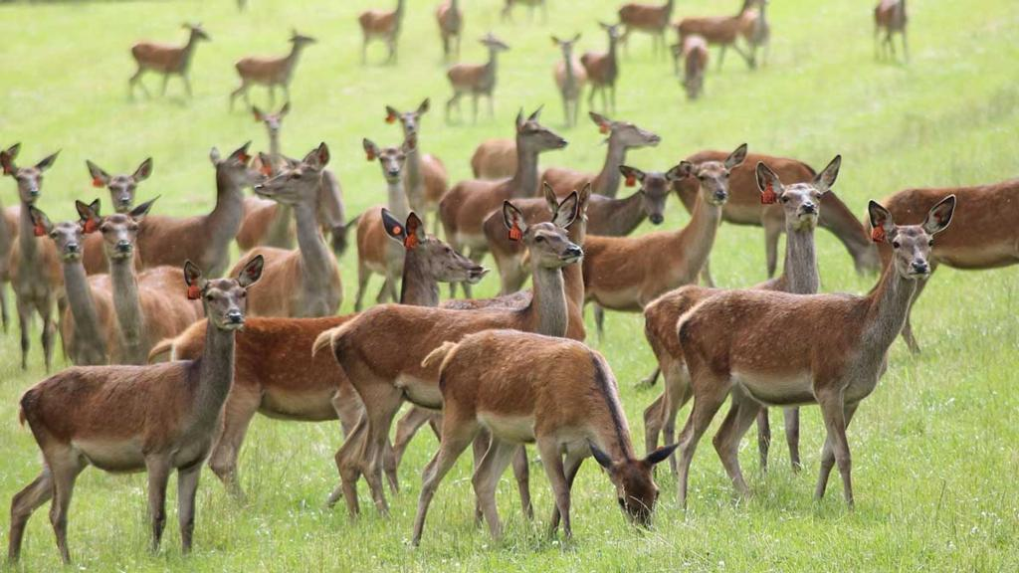
Deer and venison
Deer meat is called venison
Venison comes from farmed deer and wild deer
There are 5 deer species
Red deer are the species which are usually farmed

Slide 22

Buffalo – meat and milk
Water buffalo
Kept for meat and milk
Buffalo milk can be used to make Mozzarella cheese

Slide 23
Want to know more?
Visit www.rhet.org.uk for more information

