Slide 2
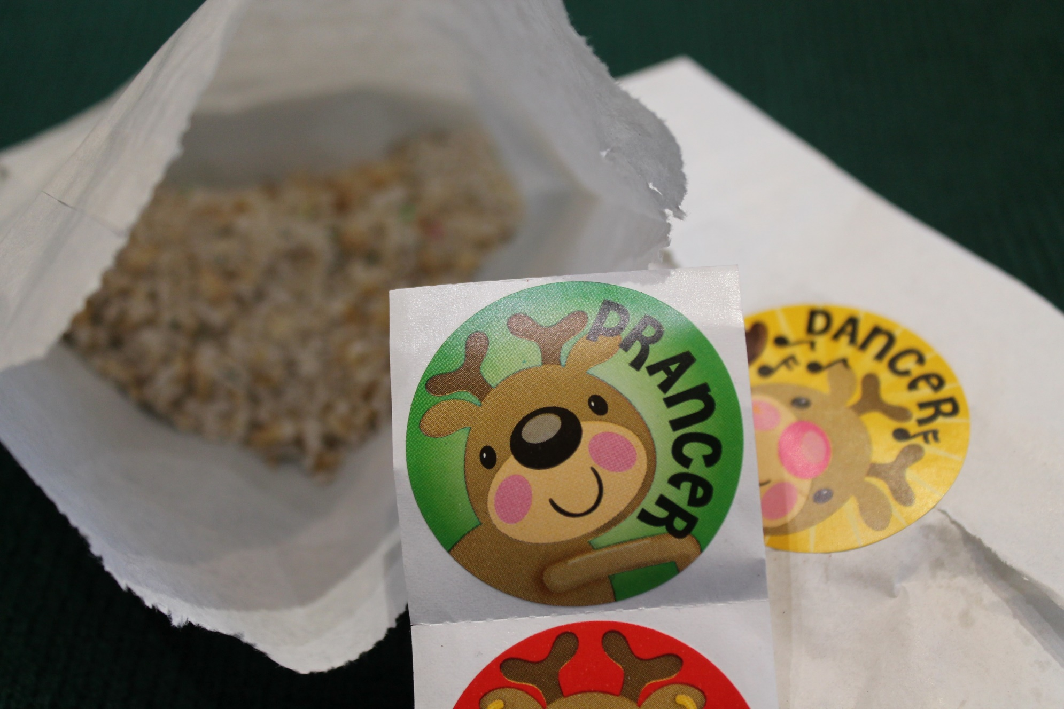
Reindeer Food Project
The Reindeer food project, aims to introduce pupils to farming, they will learn
How farmers grow food for us and other animals.
Food grown locally is better for you and the planet.
If you eat the right food, you will grow strong and healthy
To follow a simple recipe to create a present for magic animals.

Slide 3
Reindeer food and how it grows
Hamish learned how a farmer looks after the animals, grows food to makes them become fit and strong.

Slide 4
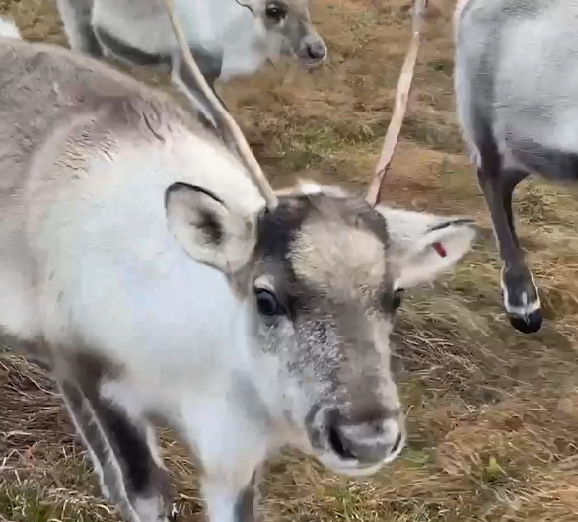
Reindeer are used to pull Santa’s Sleigh They live at the North Pole in Alaska and northern Canada

Slide 5
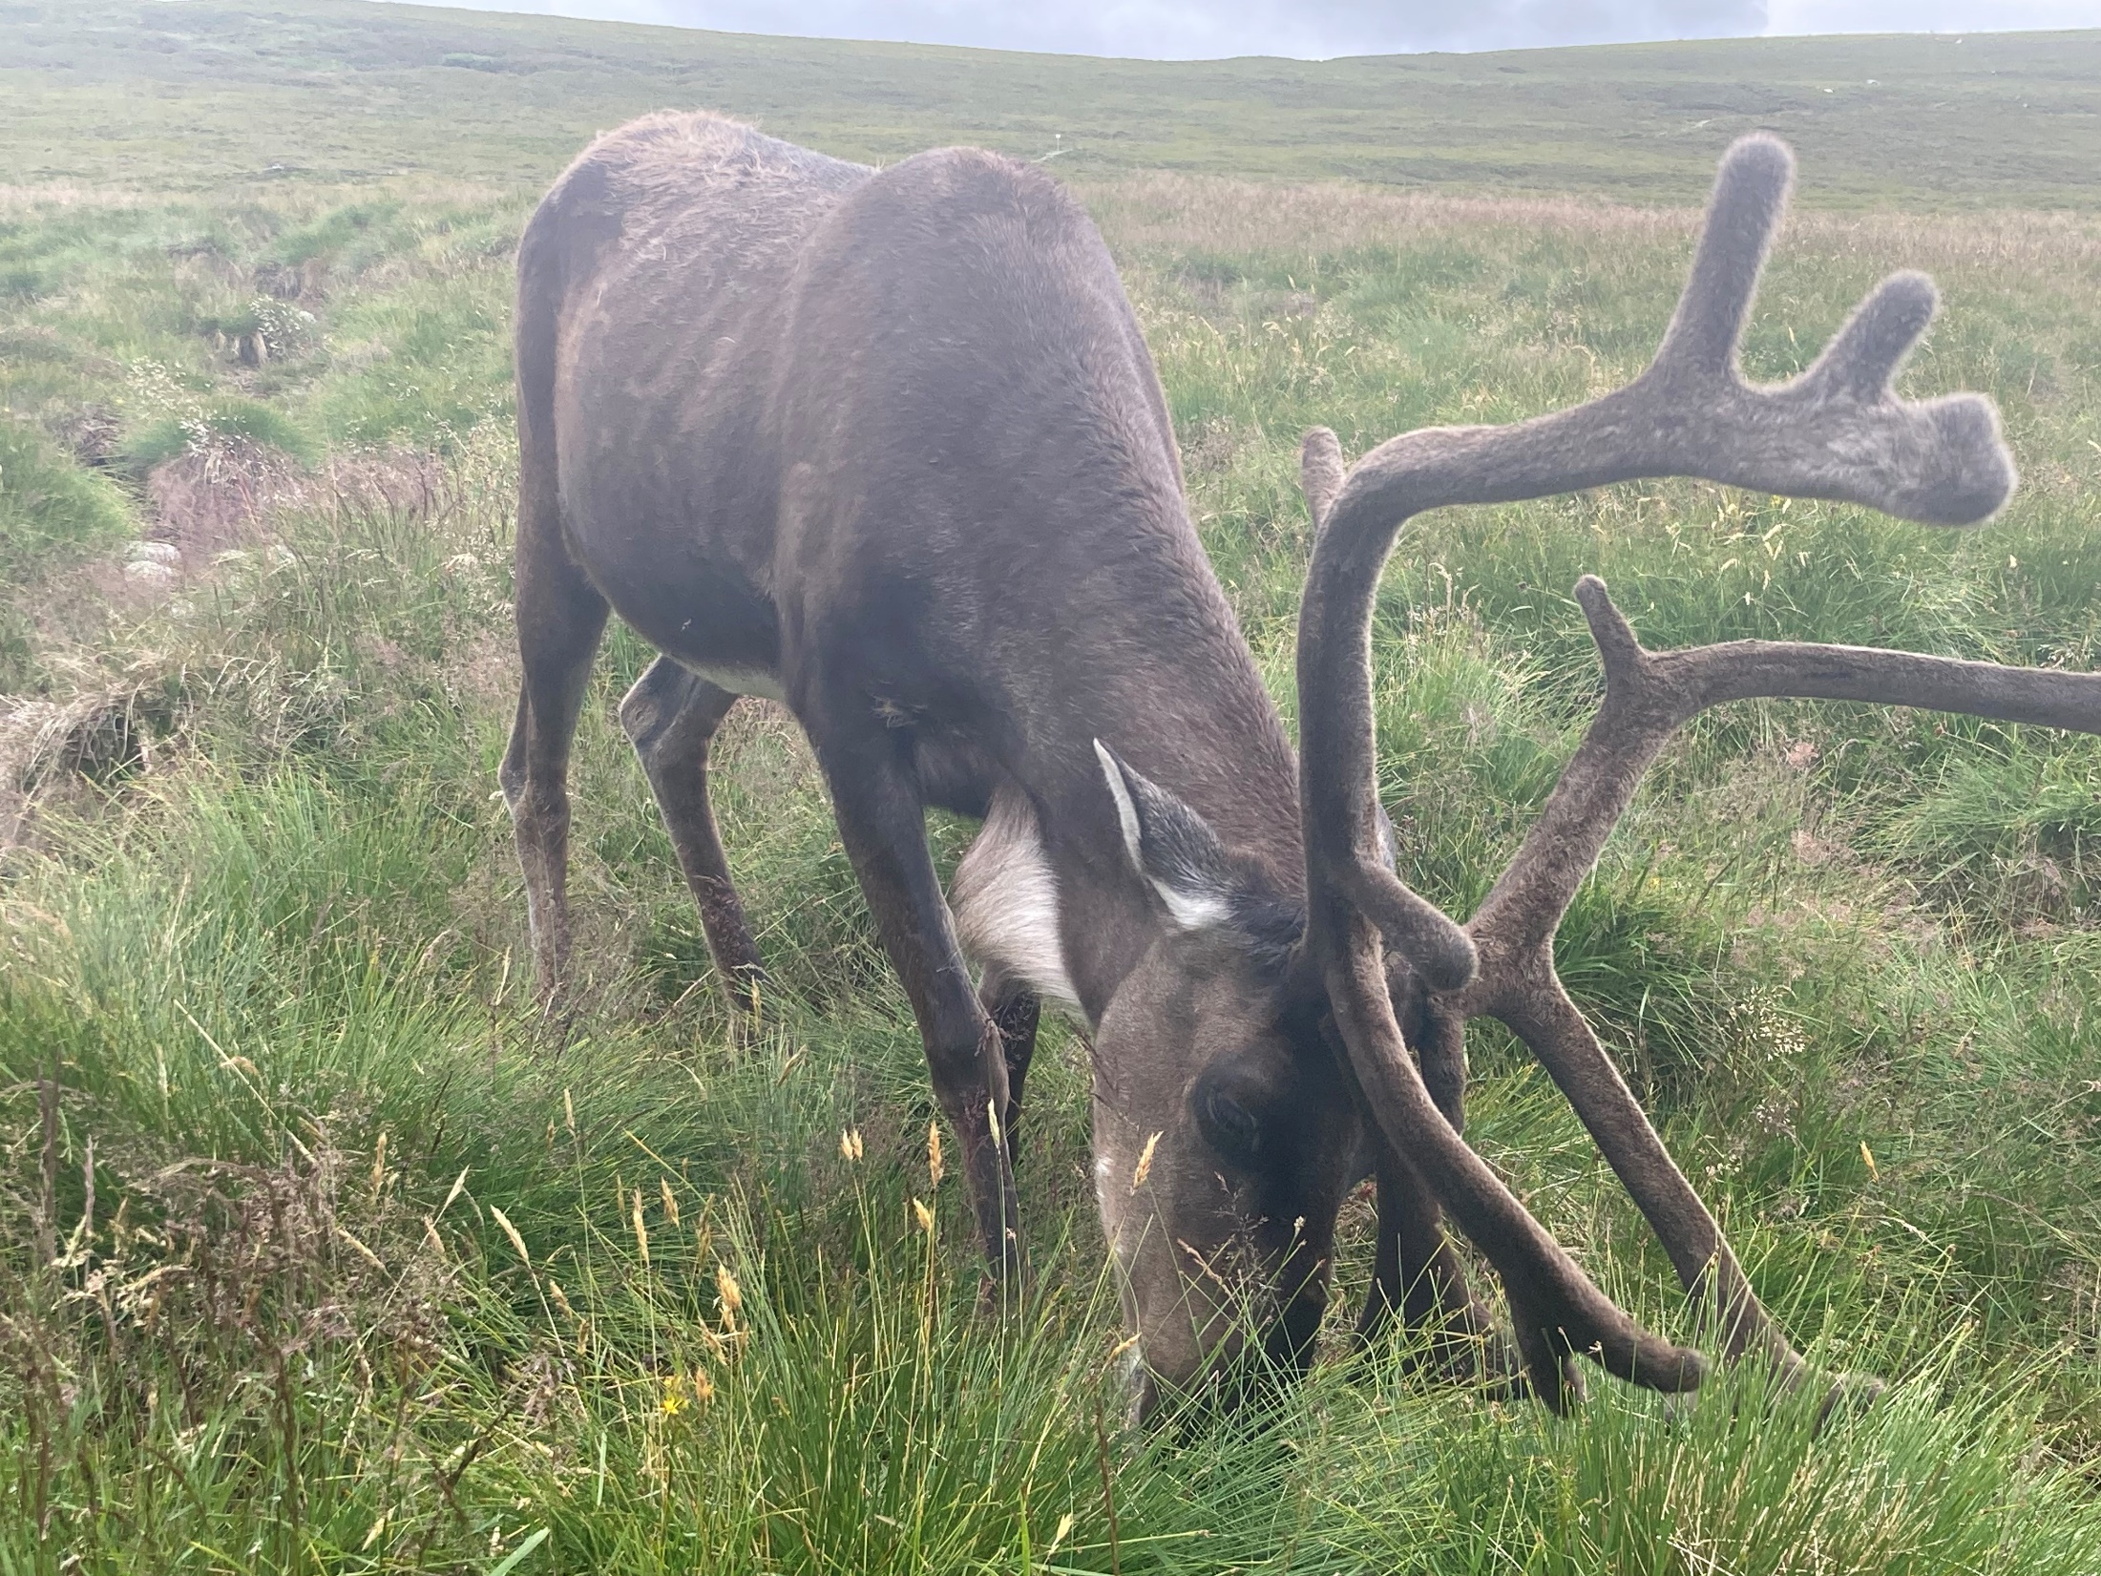
Reindeer what do they eat ?
Santa has farmer elves to look after his reindeer. What other animals would you find on a farm?
In the North Pole and other cool countries it is very snowy in the winter. Is Scotland a cool country ?
Animal adaptations

Slide 6
Reindeer what do they eat ?
In Spring and Summertime, the reindeer eat fresh grass.
In winter they eat lichens, especially reindeer moss
What are the seasons of the year ?
Farming calendar

Slide 7
Oats grow really well in Scotland, the farmers harvest them with a combine harvester. Have you ever seen a real combine harvester ?
Large images
Grain quiz

Slide 8
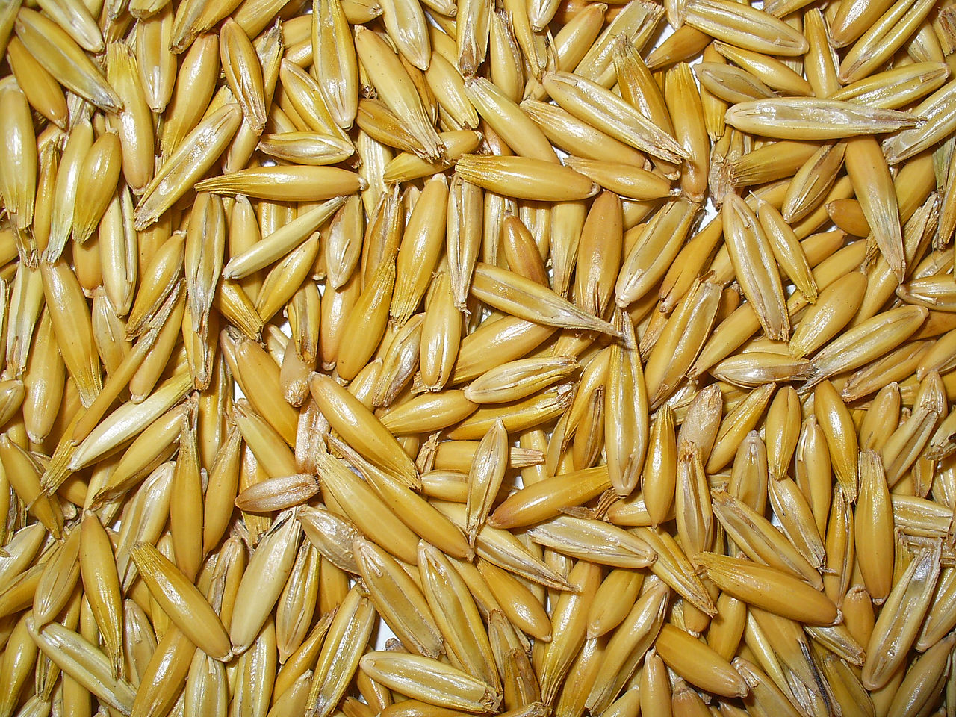
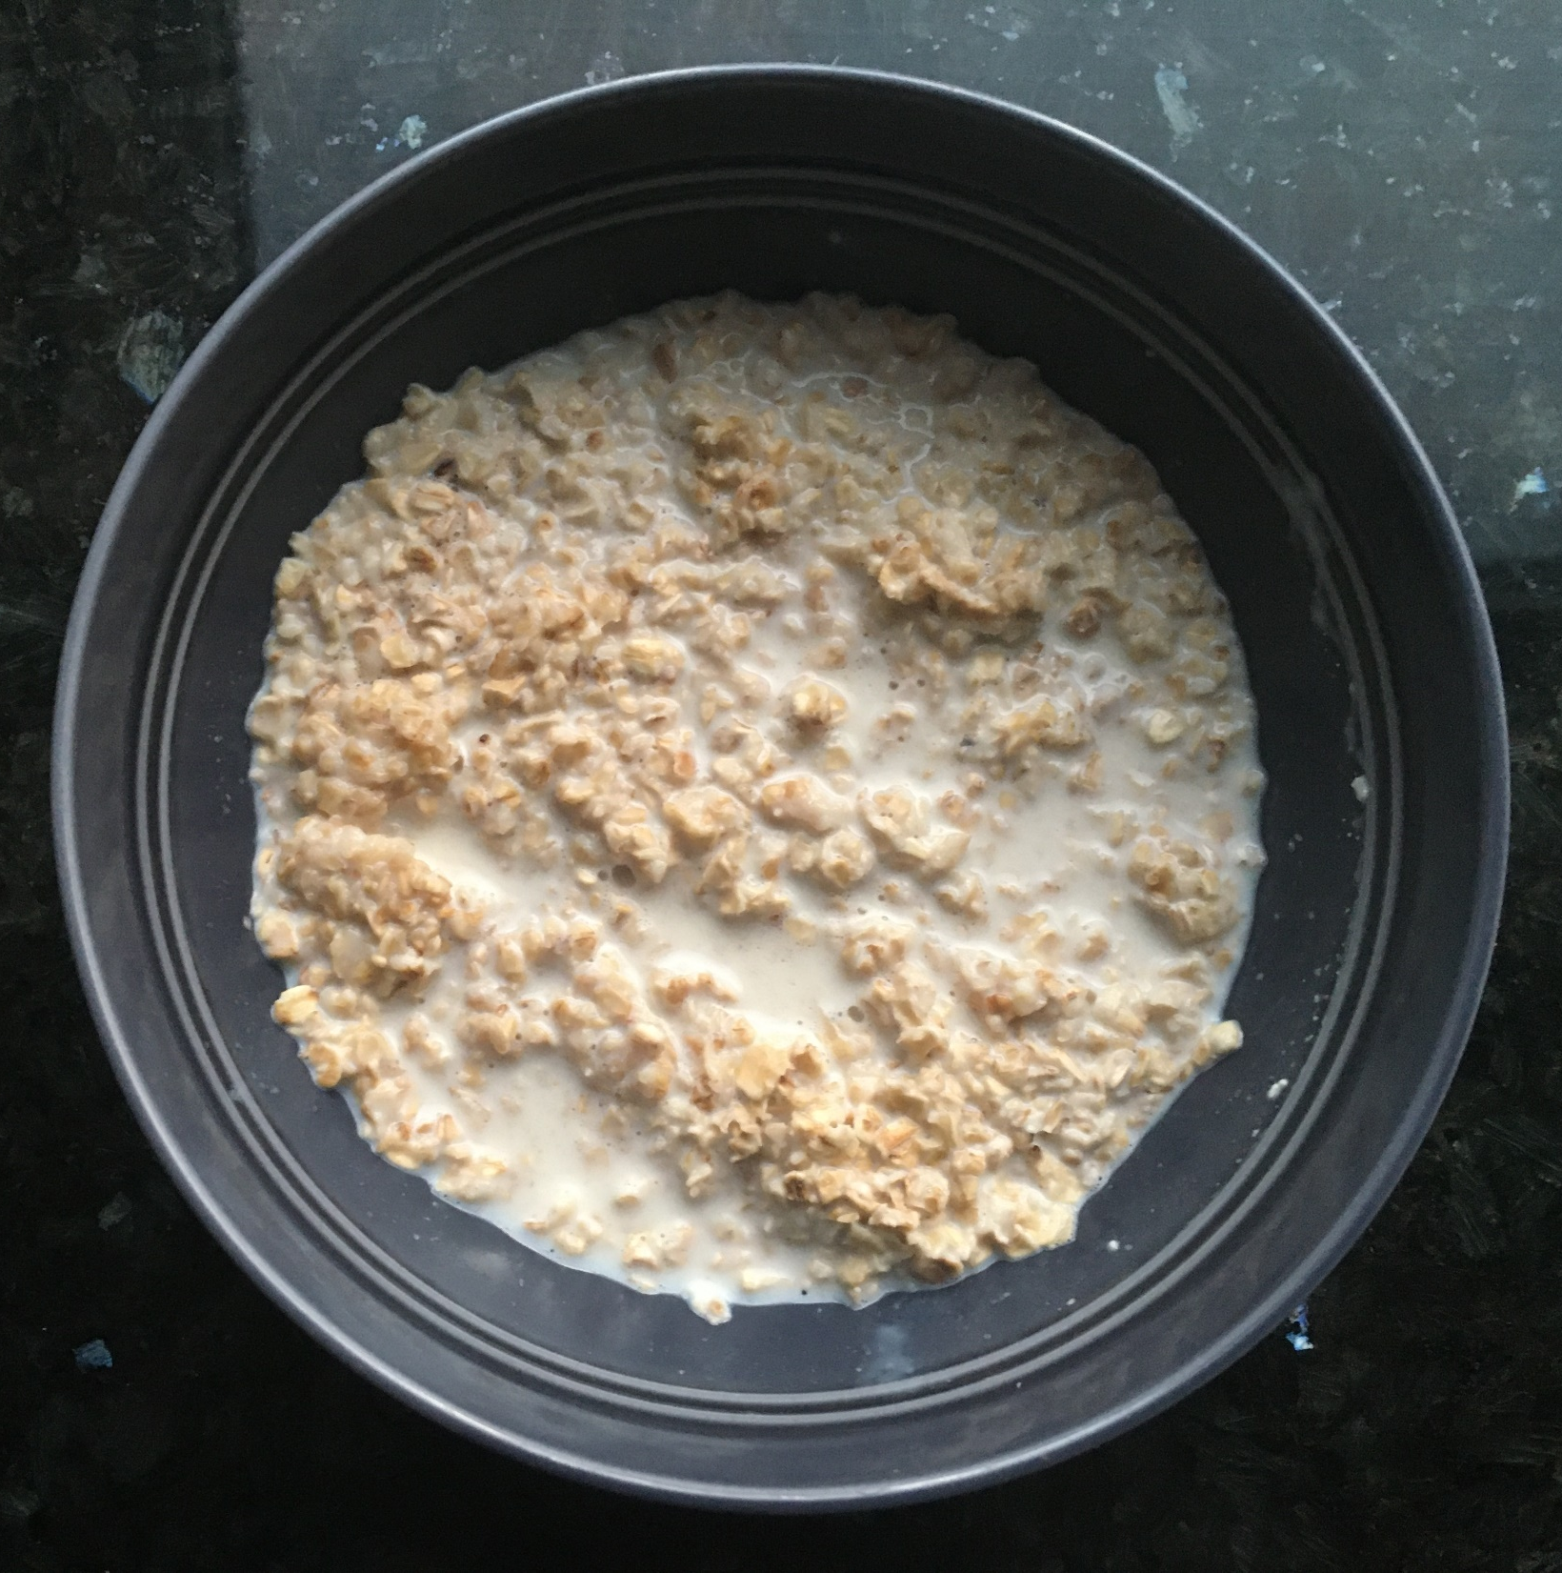
Reindeer what do they eat ?
Reindeer need a lot of energy to travel the whole way round the world, so as well as hay the farmers grow oats.
Oats keep the reindeer warm and gives them lots of energy, they are good for you too.
When do you eat oats?
Eatwell guide and museli

Slide 9
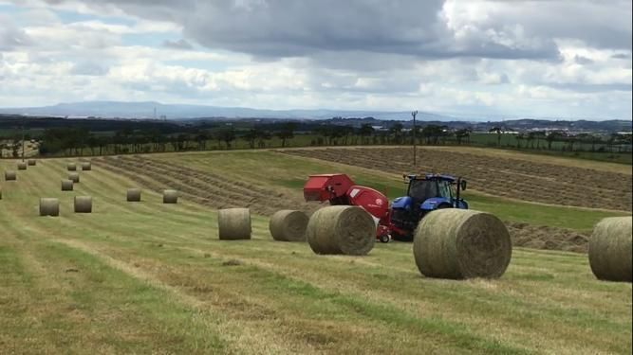
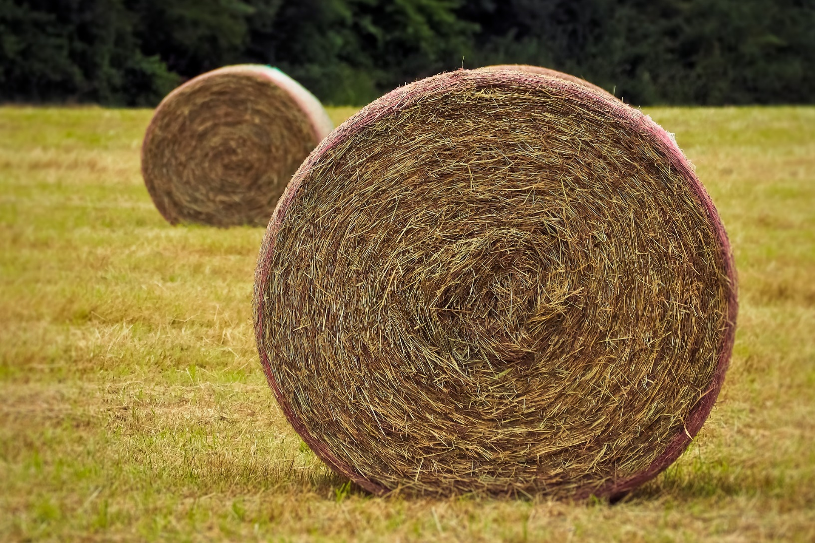
Reindeer what do they eat ?
In summer, when the grass is long, the farmers cut and dry the grass to preserve it as animal food for the winter, it is called hay.
Can you think of other animals that like to eat hay ?
What farm animals eat

Slide 10
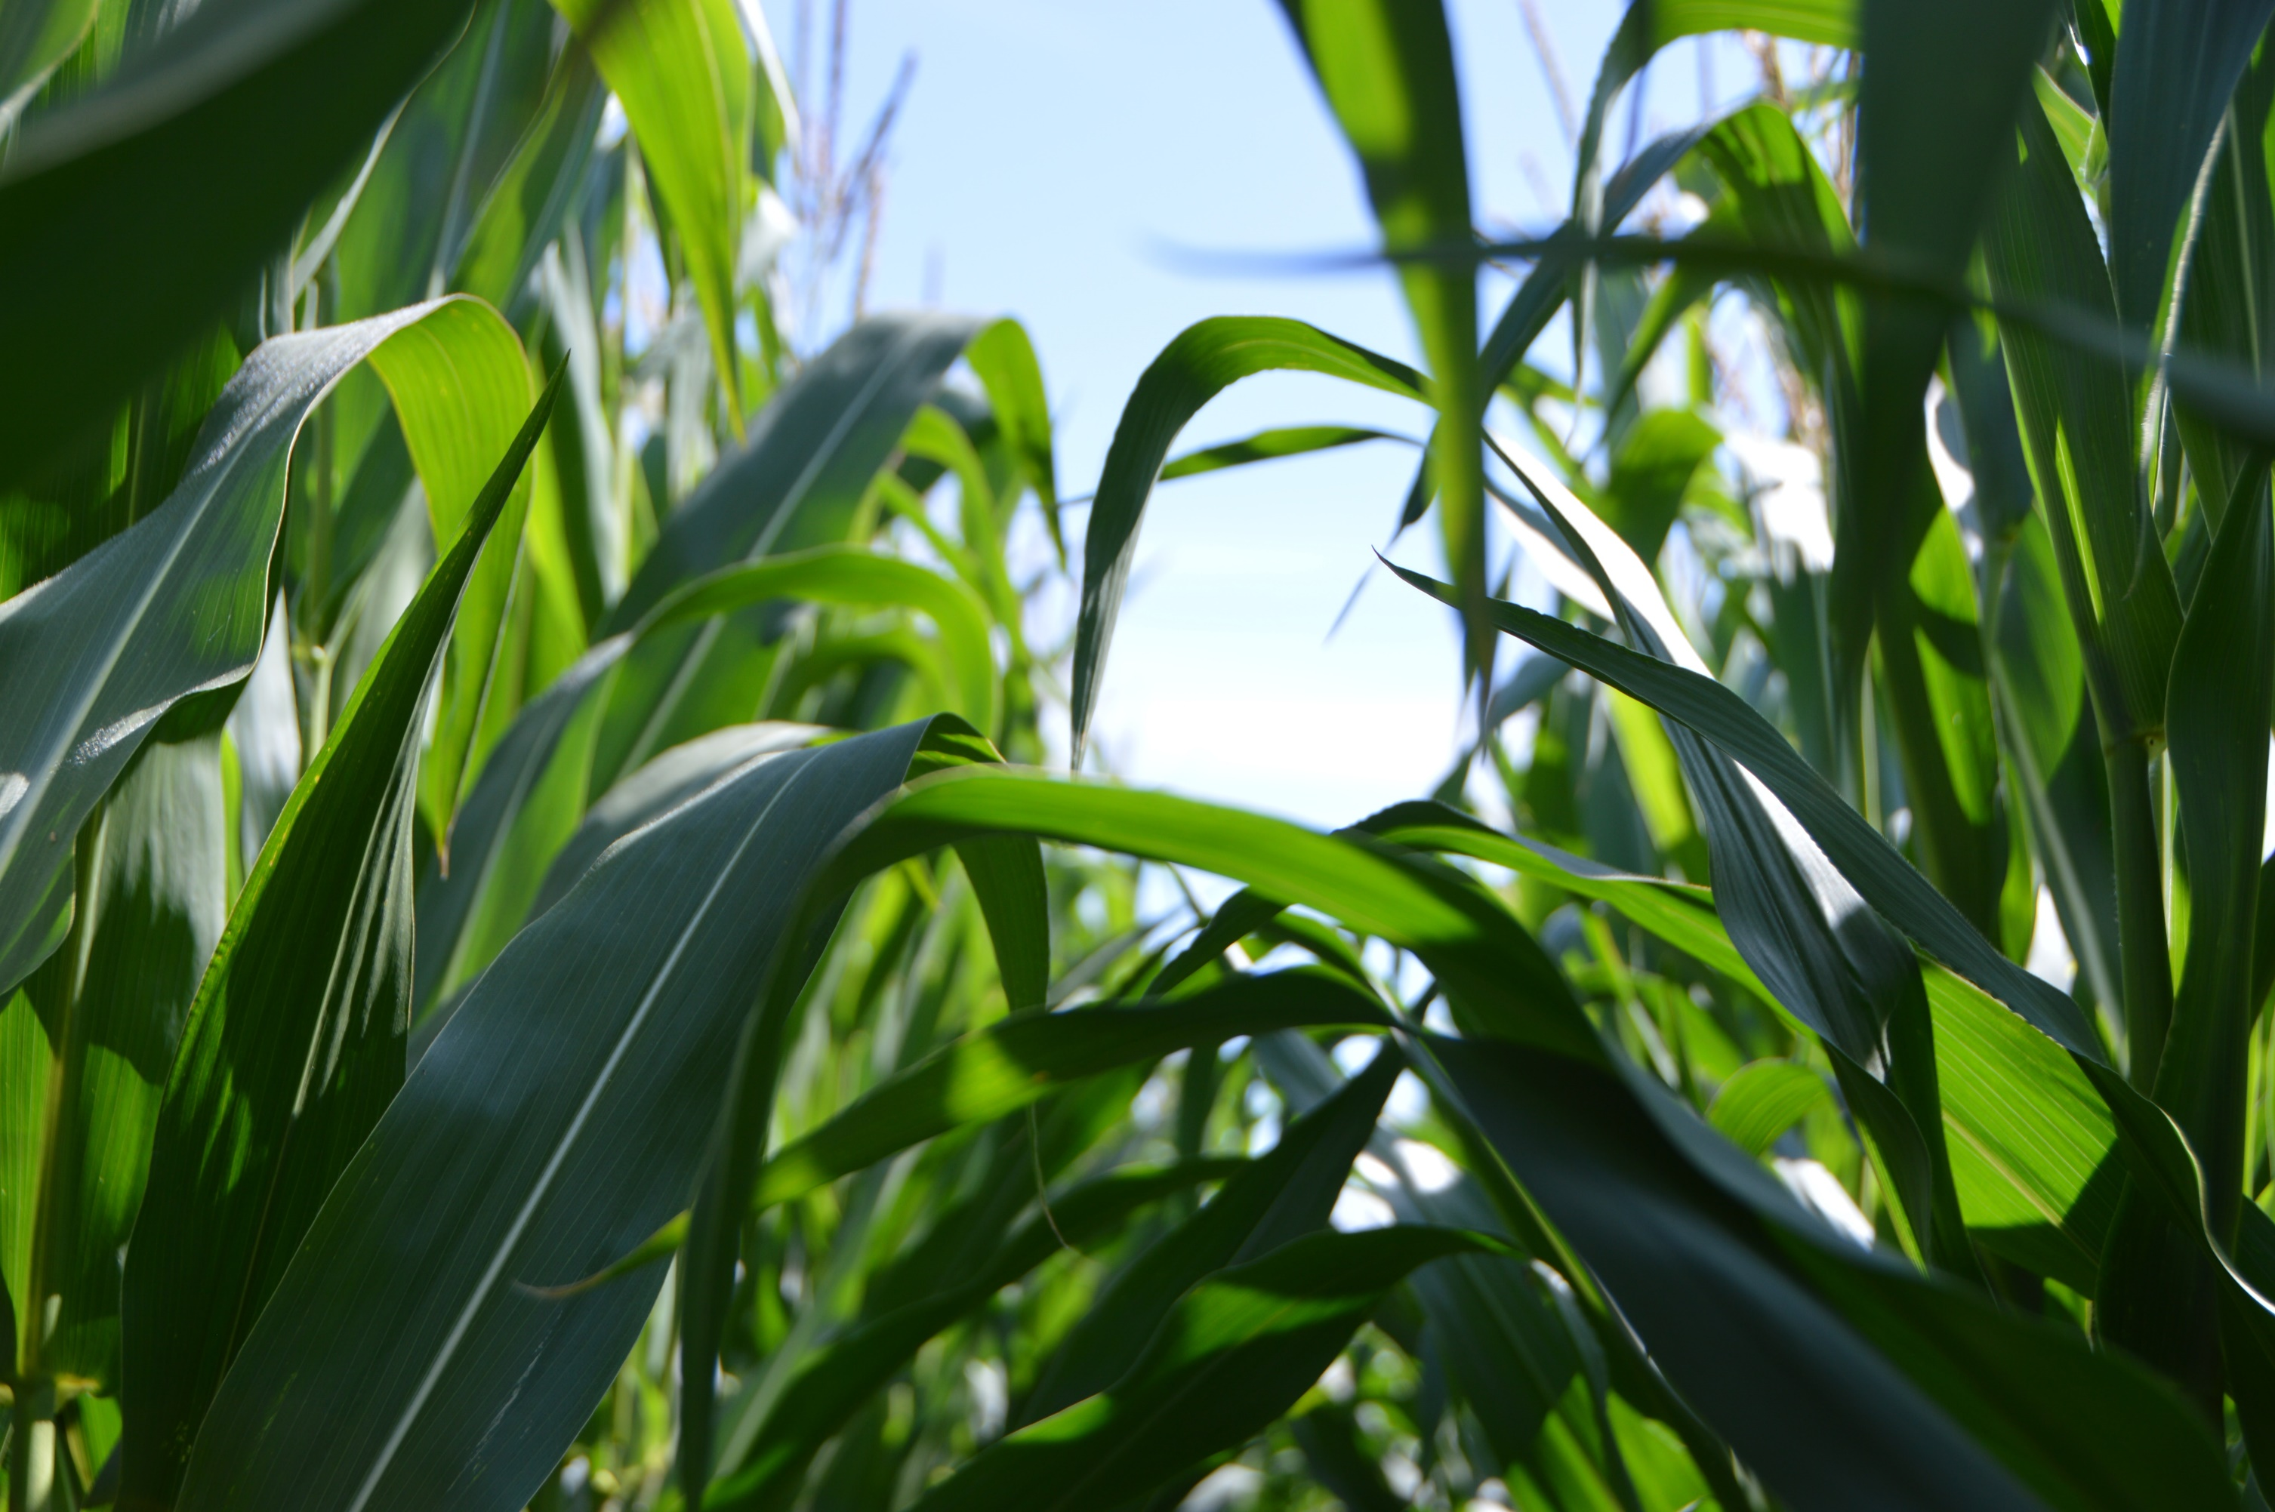
Reindeer what do they eat ?
Santa gives his reindeer popcorn, so they can take off into the sky.
Popcorn is made from corn on the cob
Corn on the cob is grown on farms too.
It comes from a very tall plant and is also harvested with a corn picker.

Slide 11
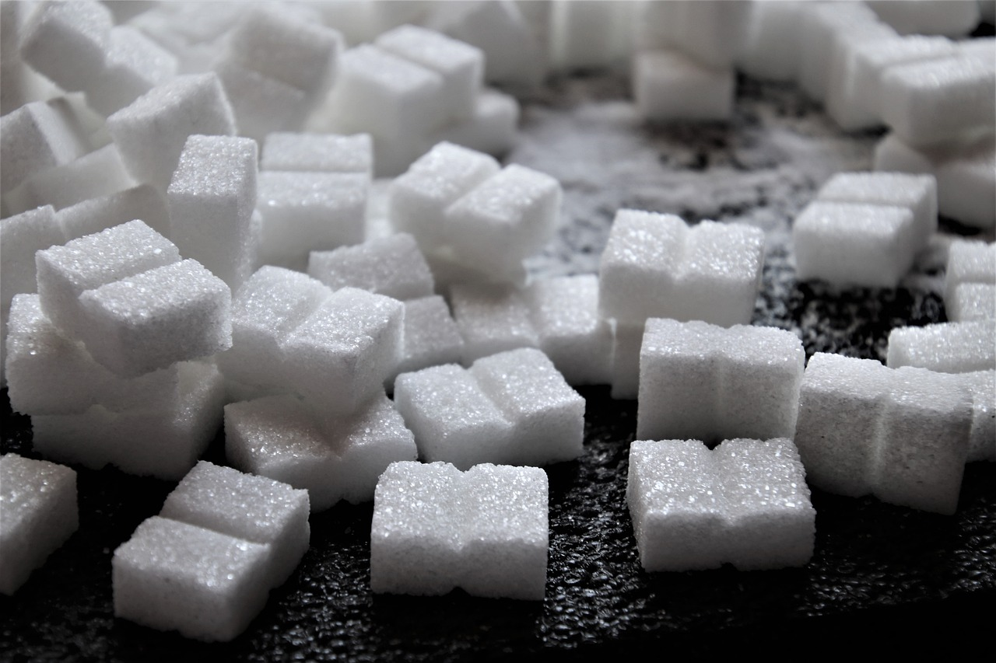
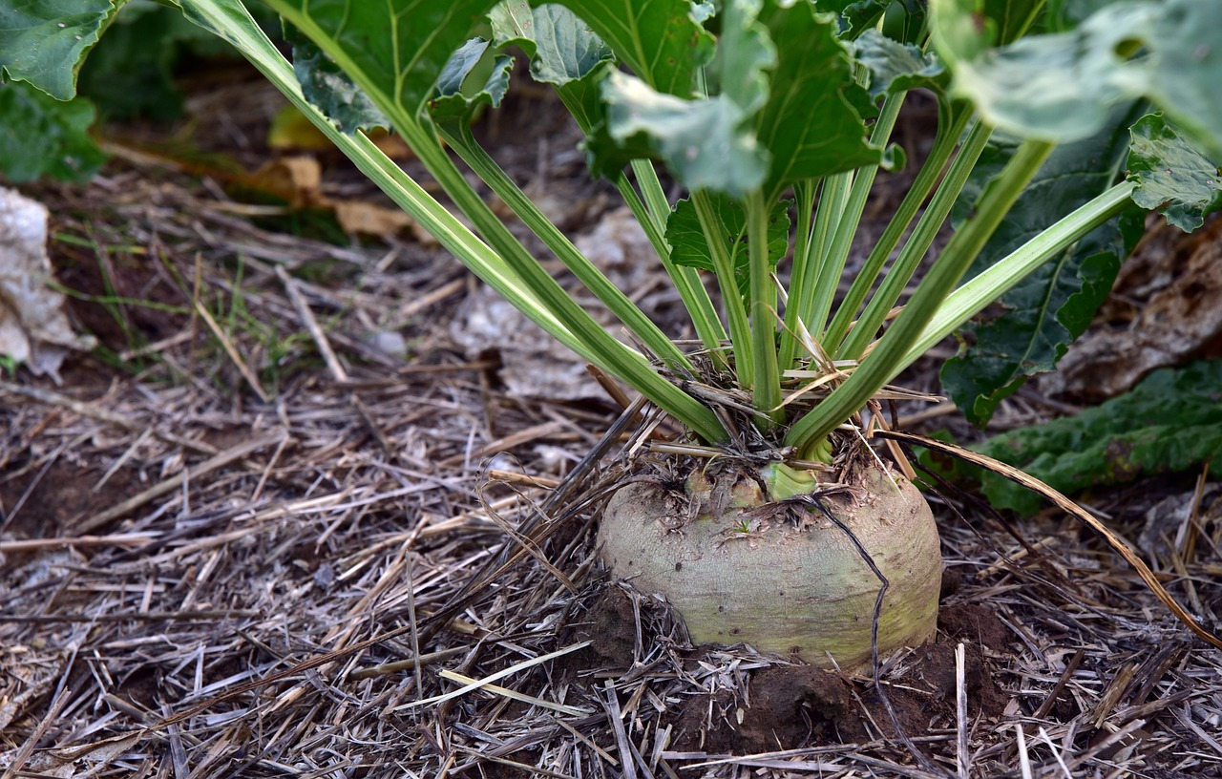
Reindeer what do they eat ?
The elves, like all farmers love to give their animals a treat. Just a little bit of sugar.
Even sugar comes from a farm, it looks like a funny turnip in the field.

Slide 12
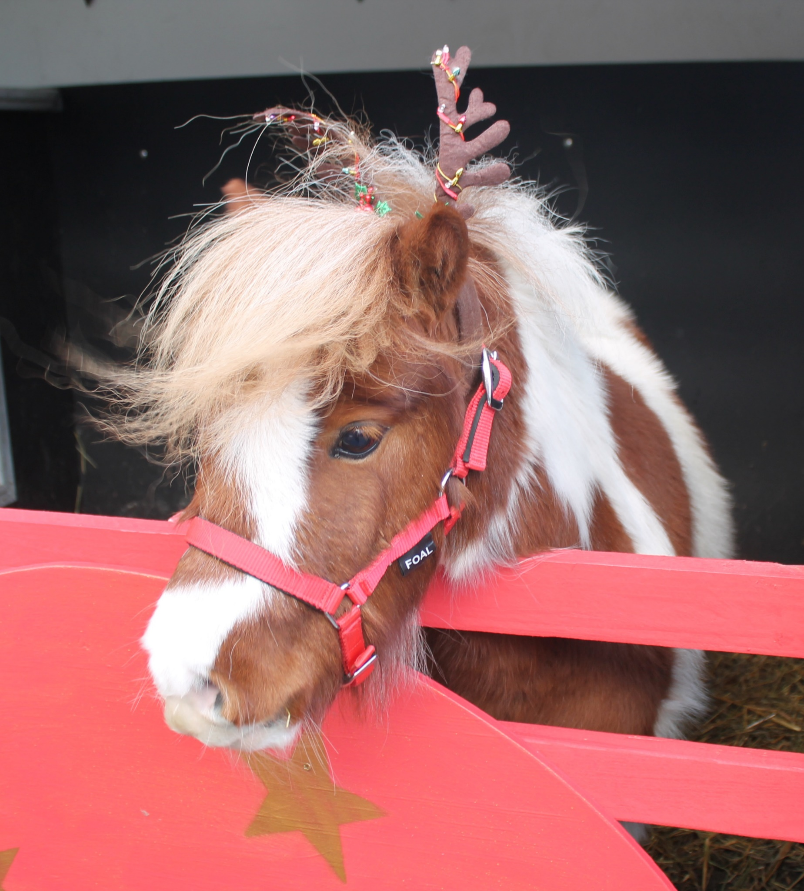
Hamish the 10th Reindeer

Slide 13
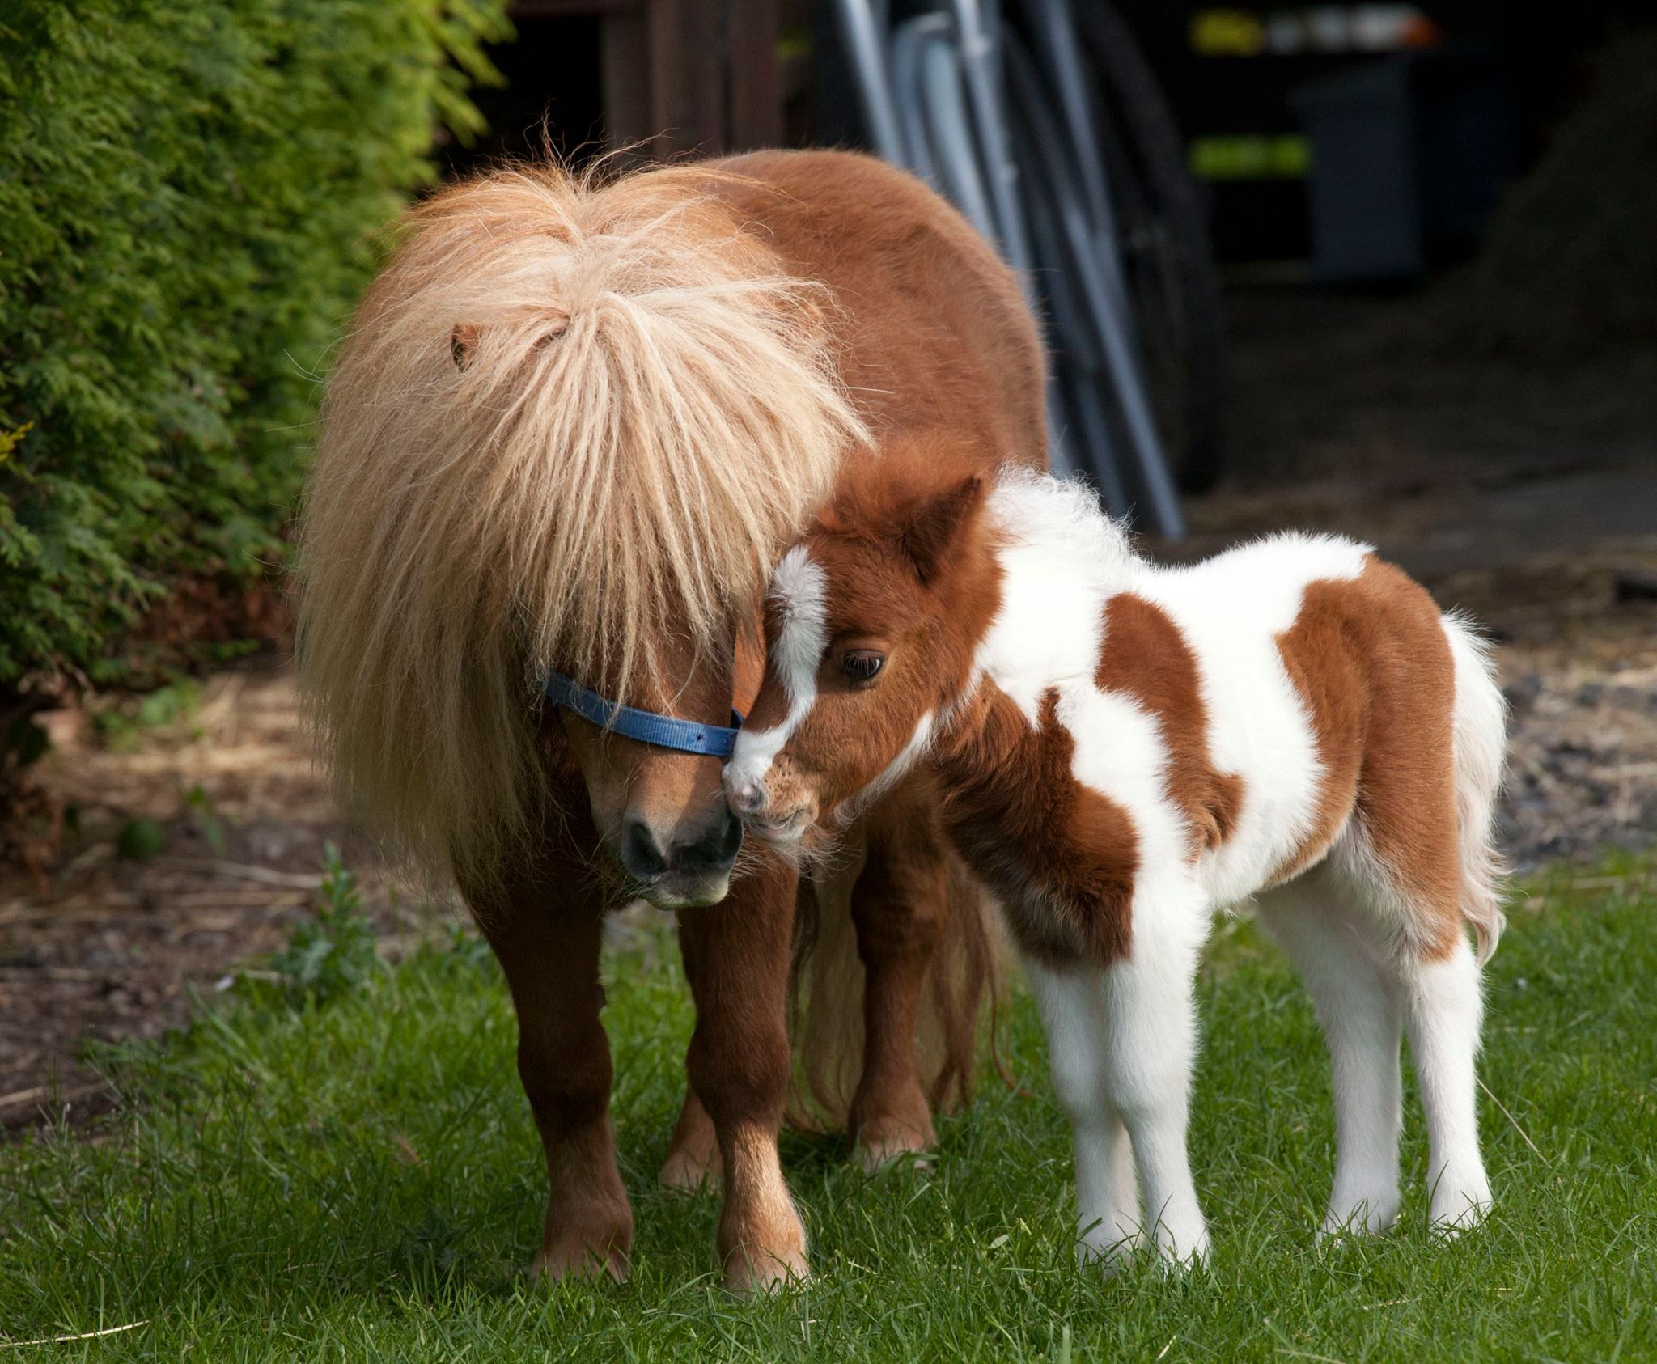
Hamish is a four year old Shetland pony, he wants to help Santa…
When he was a baby foal, he said to his Mum “when I grow up I want to be a Reindeer” he learned to run fast..

Slide 14
Hamish started school when he was 3, he had to wear a harness, so he could pull the sleigh. He even tried to fly….

Slide 15
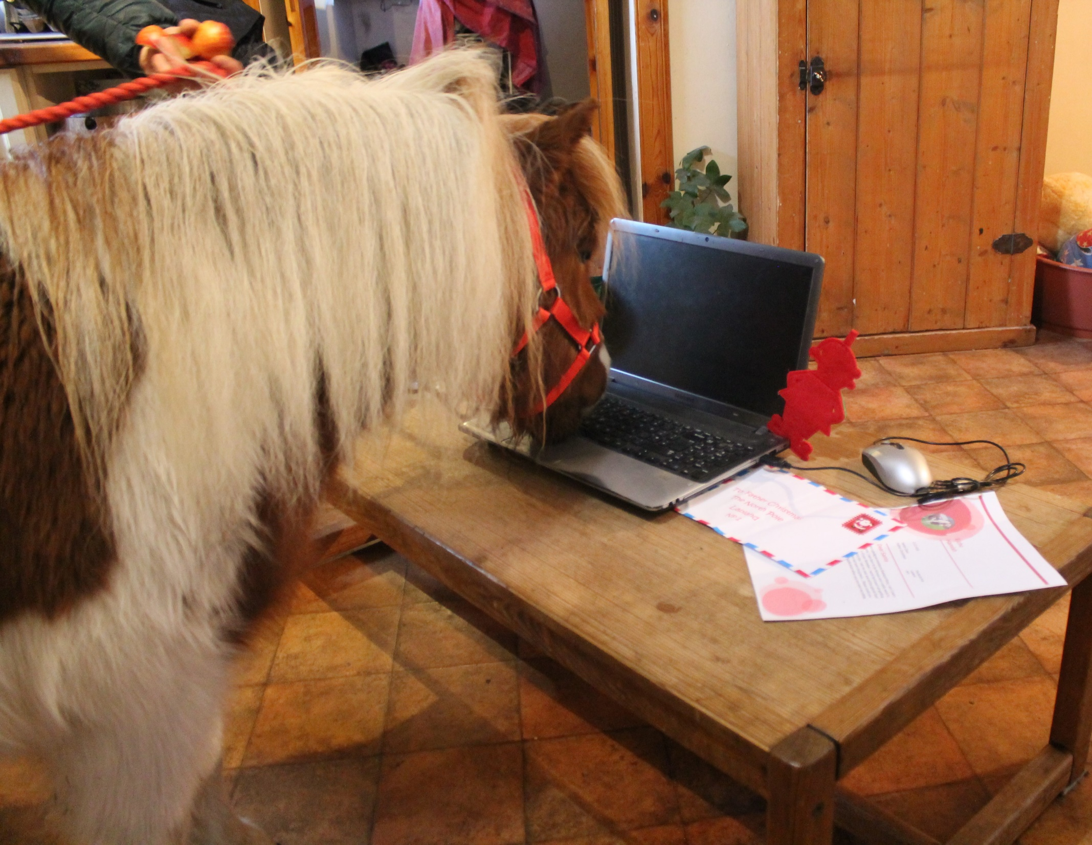
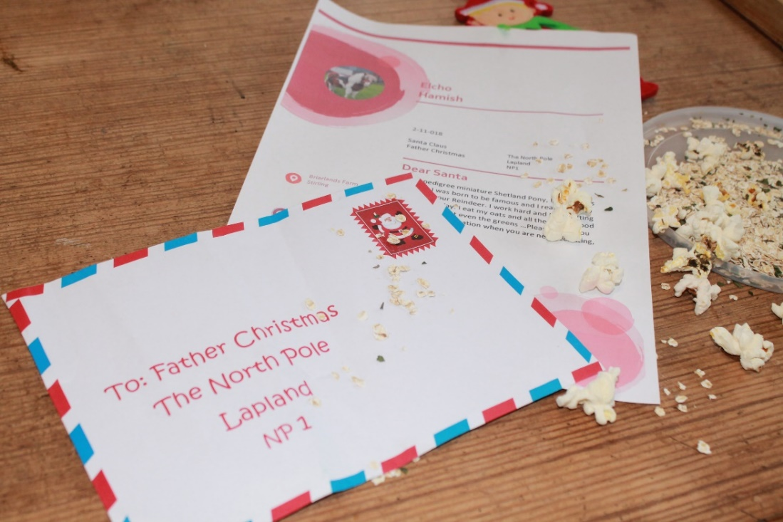
Hamish wrote his letter to Santa.
“Please can I be one of your Reindeer…….”

Slide 16
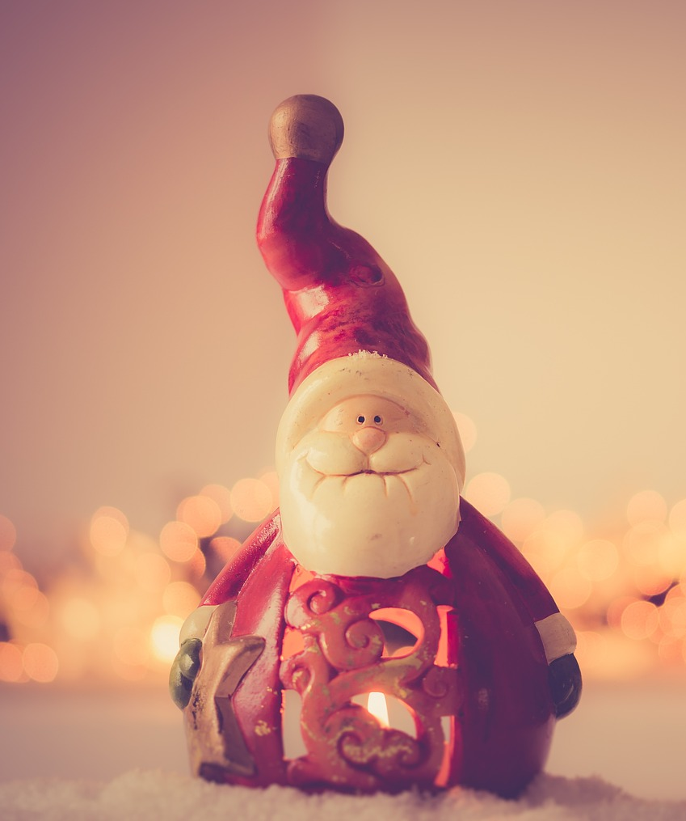
An email came back from Santa it said.. “To work for me you must be 6 years old, and be fit and strong”
So Hamish would have to wait for 2 whole years. Are you old enough to work for Santa?

Slide 17
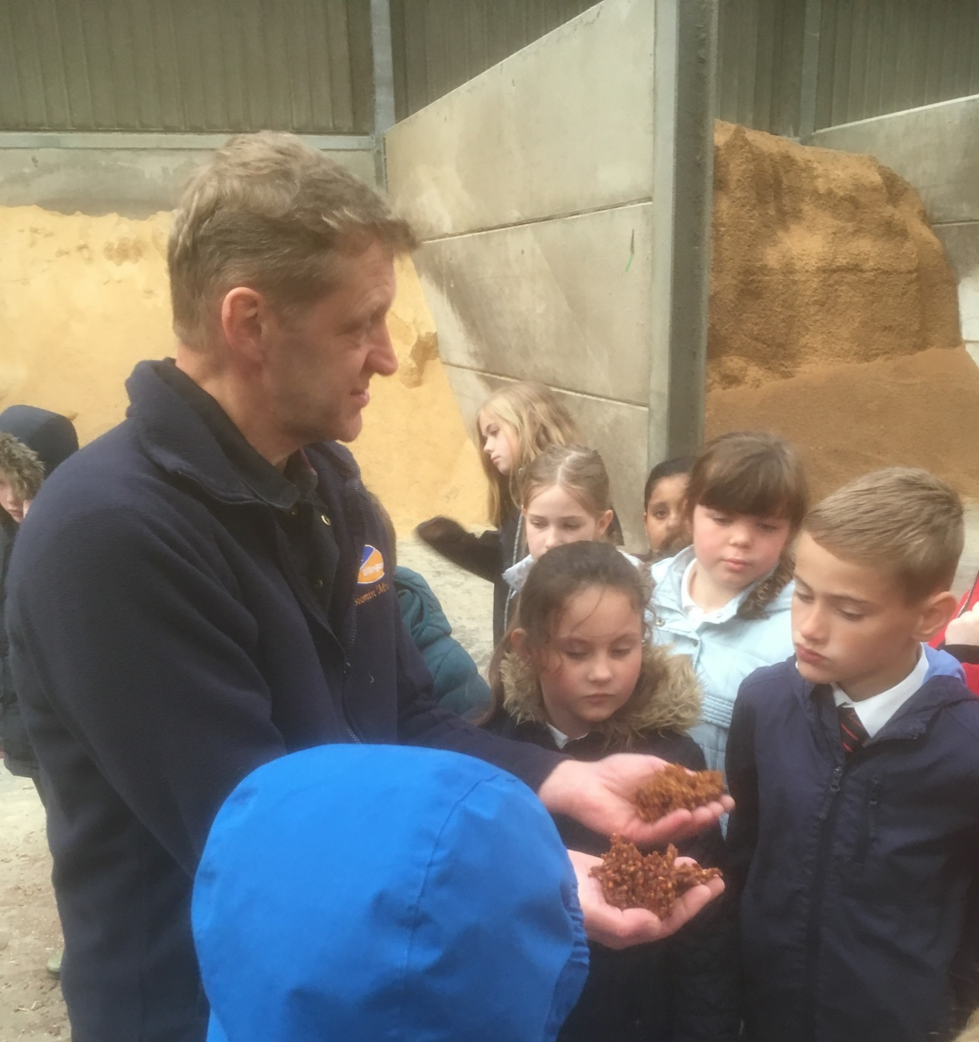
Hamish knew he would need to eat the right food to grow big and strong. He decided to asked a farmer …”What makes reindeer so strong and fast”

Slide 18
Enjoy making your special bag of food, don’t forget the Krispie wish.

Slide 19
The Recipe 1 handful of hay 1 spoonful of oats 1 pinch of sugar 3 popcorn 2 Krispies (with wishes inside)

Slide 20
Want to know more?
Visit www.rhet.org.uk for more information

